Slide 1

Module II
Regular Expression

Slide 2

Syllabus and Planner
Lecture | Topic | Book
1 | Formal definition and Construction of Regular Expression of the given Language, | T1,T2
2 | Identities of Regular Expressions Construction of Regular Expression of the given Language, | T1,T2
3 | Construction of Language from the RE, | T2
4 | FA and RE, DFA to RE Using Arden’s Theorem, Closure properties of RLs, Applications of Regular Expressions, | T2,R3
5 | RE to DFA (RE to e-NFA to DFA and RE to DFA Direct Method), | T2,R3
6 | Pumping Lemma for RL,
7 | Interconversion between Left Linear and Right linear Grammar

Slide 3
Text Books & Reference Books
Text Books
  Michael Sipser “Introduction to the Theory of Computation” CENGAGE Learning, 3rd Edition ISBN-13:978-81-315-2529-6
  Vivek Kulkarni, “Theory of Computation”, Oxford University Press, ISBN-13: 978-0-19-808458-7
Reference Books
  Hopcroft Ulman, “Introduction To Automata Theory, Languages And Computations”, Pearson Education Asia, 2nd Edition
  Daniel. A. Cohen, “Introduction to Computer Theory” Wiley-India, ISBN:978-81-265-1334-5
  K.L.P Mishra ,N. Chandrasekaran ,“Theory Of Computer Science (Automata, Languages and Computation)”, Prentice Hall India,2nd Edition
  John C. Martin, “Introduction to Language and Theory of Computation”, TMH, 3rd Edition ISBN: 978-0-07-066048-9
  Kavi Mahesh, “Theory of Computation: A Problem Solving Approach”, Wiley-India, ISBN: 978-81-265-3311-4

Slide 4
What is Regular expression
Regular expressions are short notations that can denote complex and infinite regular languages.
In arithmetic, we can use the operations + and × to build up expressions such as
(5 + 3) × 4 .
The value of the arithmetic expression is the number 32.
Similarly, we can use the regular operations to build up expressions describing languages, which are called regular expressions.
Example : (0 ∪ 1)0∗.
The value of a regular expression is a language:
language of consisting of all strings starting with a 0 or a 1 followed by any number of 0s.

Slide 5
Definition of a Regular Expression
Regular expressions over Σ, include letters, ∅(empty set) and ε(empty string of length zero).
2. Every symbol a € Σ is a regular expression over Σ.
3. If R1 and R2 are regular expressions over Σ, then so are (R1+R2),(R1.R2) and (R1)*
[Where ‘+’ indicates union,
‘.’ indicates concatenation,
‘*’ indicates closure or repetitive concatenation]
4. Regular expressions are only those that are obtained using rules1-3.

Slide 6
Operators of RE
Regular Expression operators:
  The Star operator :Closure
  if r = a* then L(r) = (€,a,aa,aaa,aaaa,….)
  2. The Dot operator :Concatenation
  if r = a.b then L(r) = (ab)
  3. The Plus operator :Union
  if r = a+b then L(r) = (a,b)

Slide 7
Example2:
Let the alphabet Σ be the standard 26 letters {a, b, . . . , z}.
If A = {good, bad} and B = {boy, girl}, then
A ∪ B = {good, bad, boy, girl},
A ◦ B = {goodboy, goodgirl, badboy, badgirl}, and
A∗ = {ε, good, bad, goodgood, goodbad, badgood, badbad,
goodgoodgood, goodgoodbad, goodbadgood, goodbadbad, . . . }.

Slide 8
Continued…
“a+b” stands for either a or b (parallel)
“a.b” stands for a followed by b (series)
“a*” stands for any no of occurrences of a(Closure).
a
a
q₀
q₁
q₀
a
q₁
b
q₂
q₀
b
(2)
(3)
(1)

Slide 9
Precedence of Regular Expression operators
  The Star operator :Closure
  The Dot operator :Concatenation
  The Plus operator :Union
E.g.
01*+1 is grouped as (0(1*))+1
1 plus all strings consisting of a 0 followed by any no of 1’s.
(01)*+1
all strings consisting of 1 plus zero or more occurrences of 01.
0(1*+1)
all strings starting with 0 followed by any no of 1’s.

Slide 10
Identities of regular expressions
R U Φ=R
Adding the empty language to any other language will not change it.
Φ . R = R Φ = Φ
if R = 0, then L(R) = {0} but L(R ◦ ∅) = ∅.
3. € . R =R€ =R
Joining the empty string to any string will not change it
4. €*= € and Φ*= €
5. R + R = R
6. R*R *= R*
7. RR* = R*R
8. (R*)=R*
9. € +RR *= R*= € +R*R
10. (PQ*)P = P(QP)*
11. (P + Q)* = (P*Q*)* = (p*+Q*)*
12. (P+Q)R=PR+QR and R(P+Q)=RP+RQ

Slide 11
Examples
True or False?
Let R and S be two regular expressions. Then:
  ((R*)*)* = R* ?
  (R+S)* = R* + S* ?

Slide 12
Construction of RE from regular Language
1. All strings of 0’s and 1’s
(0 + 1)*
2. 0 followed by any number 1’s
01*
3. L={01, 10}
01 ∪ 10
4. The language of all binary strings over ∑={0,1} starting with 01
01(0+1)*
5. The language of all binary strings ending at 01
(0+1)*01.
6. The language of all binary strings having substring 01
(0+1)*01(0+1)*

Slide 13
Continued…
7. If L(r) ={aaa,aab,aba,abb,baa,bab,bba,bbb} find r.
Ans:(a+b)3
8. If L(r) ={a,c,ab,cb,abb,cbb,abbb….} find r.
Ans:(a+c).b*
9. If L(r) ={€,x,xx,xxx,xxxx,xxxxx} find r.
Ans:(€+x) (€+x) (€+x) (€+x) (€+x)
10. The set of all strings of 0’s and 1’s such that the tenth symbol from the right is 1.
(0+1)*.1.(0+1)⁹

Slide 14
Construction of Regular Language from RE
(0|1)*011
all strings of 0’s and 1’s ending in 011
2) 0*1*2*
any number of 0’s followed by any number of 1’s followed by any number of 2’s
3) 00*11*22*
strings in 0*1*2 with at least one of each symbol
4)(0*1*)*000(0+1)*
strings with 3 consecutive 0’s.
5) R= (0 ∪ ε)(1 ∪ ε)
L= {ε, 0, 1, 01}

Slide 15
Construction of Regular Language from RE
6) (∑∑)*
{w| w is a string of even length}
7) (∑∑∑)*
{w| length of w is a multiple of 3}
8) Φ*= ?
€
9) R . € =?
R

Slide 16
Equivalence of FA and RE
Finite automata (DFA and NFA) and regular languages are equivalent.
Every regular language can be recognized (accepted) by a finite automata and,
conversely, for every finite automata there is a regular language which is the language accepted by the finite automata.

Slide 17
RE to FA
For Ø:
For ε:
For a:
q₀
q_{f}
q₀
a
q_{f}

Slide 18
Example:
r = 0(0+1)*
r = r₁r₂
r₁ = 0
r₂ = (0+1)*
r₂ = r₃*
r₃ = 0+1
r₃ = r₄ + r₅
r₄ = 0
r₅ = 1
q₀
1
q₁

Slide 19
Example:
r = 0(0+1)*
r = r₁r₂
r₁ = 0
r₂ = (0+1)*
r₂ = r₃*
r₃ = 0+1
r₃ = r₄ + r₅
r₄ = 0
r₅ = 1
q₀
1
q₁
q₂
0
q₃

Slide 20
Example:
r = 0(0+1)*
r = r₁r₂
r₁ = 0
r₂ = (0+1)*
r₂ = r₃*
r₃ = 0+1
r₃ = r₄ + r₅
r₄ = 0
r₅ = 1
ε
q₀
1
q₁
ε
q₄
q₅
ε
q₂
0
q₃
ε

Slide 21
Example:
r = 0(0+1)*
r = r₁r₂
r₁ = 0
r₂ = (0+1)*
r₂ = r₃*
r₃ = 0+1
r₃ = r₄ + r₅
r₄ = 0
r₅ = 1
ε
ε
q₀
1
q₁
ε
q₆
ε
q₄
q₅
ε
q_{f}
ε
q₂
0
q₃
ε
ε

Slide 22
Example:
r = 0(0+1)*
r = r₁r₂
r₁ = 0
r₂ = (0+1)*
r₂ = r₃*
r₃ = 0+1
r₃ = r₄ + r₅
r₄ = 0
r₅ = 1
q₈
0
q₉
ε
ε
q₀
1
q₁
ε
q₆
ε
q₄
q₅
ε
q_{f}
ε
q₂
0
q₃
ε
ε
Solve R = 0 * 1* 2*

Slide 23
RE to FA
(a+b).(a+b)*
a.(a+b)*
Solve using Direct method and converting to NFA and then to DFA method.
0* 1* 2*

Slide 24
Practice problems
R=[1.(00)*.1 +0.1*.0]*
(0+1)* 0 (0+1) (0+1)

Slide 25
Arden's Theorem
Statement:
Let P and Q be two Regular Expression s over Σ.
If P does not contain Λ, then for the equation
R = Q + RP has a unique(one and only one solution R = QP*.

Slide 26
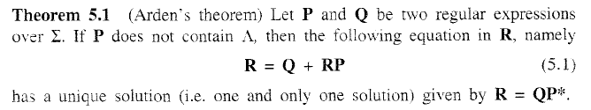
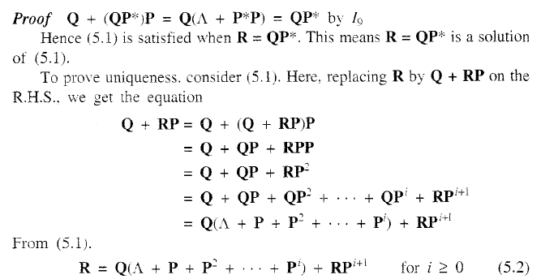
Arden’s theorem

Slide 27
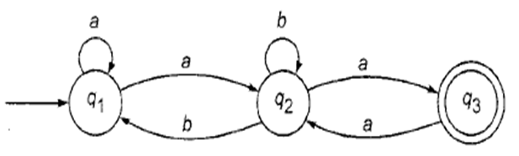
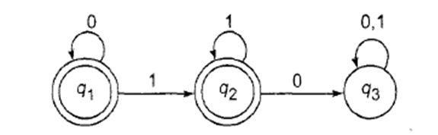
Examples
1)
2)

Slide 28
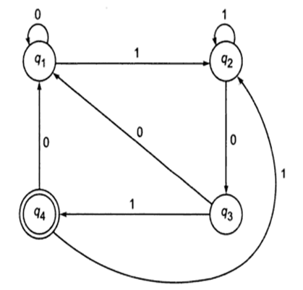
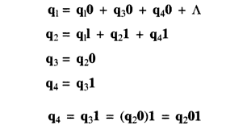
Arden’s theorem
3)

Slide 29
Limitations of RE
FSM does not have the capacity to remember large amount of information.
2. The head can not move in reverse direction.
3. It cannot recognize the languages which are not regular.
e.g. Palindrome.
4. FSM cannot multiply the numbers.

Slide 30
Contents
Left linear grammar to right linear grammar
Right linear grammar to Left linear grammar
Proving Languages not to be Regular
1. The Pumping Lemma for Regular Languages
2. Applications of the Pumping Lemma
Closure Properties of Regular Languages
Application of Regular Expression

Slide 31
Left linear grammar to right linear grammar
  Every left linear grammar can be represented by an equivalent right linear grammar
  The conversion process involves drawing of an intermediate transition graph .
  Steps as follows :
  Represent the left linear grammar using the transition graph
  Interchange the start state as end state
  Reverse the direction of all transitions
  Write Right linear grammar from the transition graph

Slide 32
Example .
Q. Write an equivalent right linear grammar from the given left linear grammar
S->C0|A0|B1
A->A1|C0|B1|0
B->B1|1
C->A0
Answer : After following the conversion steps
S-> 1B|0A
A-> 0C|1A|0
B-> 1B|1A|1
C-> 0C|0

Slide 33
Q. Write an equivalent right linear grammar from the given left linear grammar
S->S10|0
Answer: After following the conversion steps
S->0X|0
X->10X|10

Slide 34
Right linear grammar to Left linear grammar
Every right linear grammar can be represented an equivalent left linear grammar .
Conversion process involves drawing of an intermediate transition graph.
Steps to follow :
1. represent the right linear grammar using the transition graph .
2.interchange the start state as final state
3. Reverse the direction of all transition
4. Write left linear grammar from the transition graph .

Slide 35
Q. Write an equivalent left linear grammar from the given right linear grammar .
S->bB|b
B-> Bc
B->aB
C->a
B->b
Answer : After following the conversion steps
S->b|Bb|Ca
B->Ba|b
C->Bb

Slide 36
Q. Write an equivalent left linear grammar from the given right linear grammar.
S->0A|1B
A->0C|1A|0
B->1B|1A|1
C->0|0A
Answer : After following the conversion steps
S-> C0|A0|B1
A->A1|C0|B1|0
B->B1|1
C->A0

Slide 37
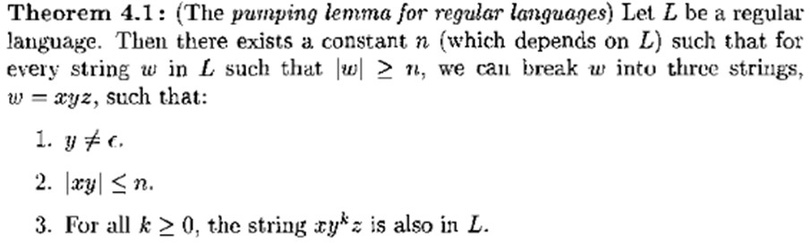

The pumping lemma for Regular Languages

Slide 38
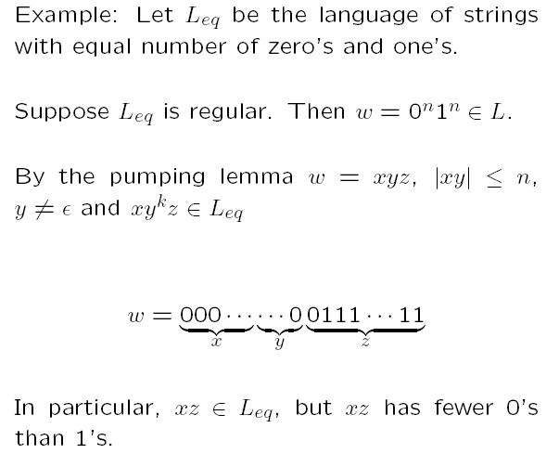
Applications of the Pumping Lemma

Slide 39
Show that the language L_{eq} consisting of all strings with an equal number of 0s and 1s (not in any particular order) is not a regular language.
Applications of the Pumping Lemma
Sol^{n}:
Suppose that L_{eq} were regular.
Then there would be a constant n satisfying the conditions
of the pum_{n}pi_{n}ng lemma.
_{Let} w = 0 1 .
By the pumping lemma, we can break, w = xyz such that
y ≠ ε and |xy| ≤ n.
5

Slide 40
 xy ≤ n and y ≠ ε
Applications of the Pumping Lemma
Now, |w| = |0^{n}1^{n}| = n + n = 2n.
∴ y = 0 ^{p} , where 0 < p ≤ n.
∴ y = 0 ^{p} = p
Now by the pumping lemma, the string xy^{n}z is in L_{eq}. Here, |xy^{n}| = |x| + n|y| ≥ np > n
Therefore the string xy^{n}z has n 1s and more than n 0s.
So xy^{n}z cannot be in L_{eq}, which contradicts our assumption.
Thus the language L_{pr} is not a regular language.
6

Slide 41
Show that the language L_{pal} consisting of all strings of 0s and 1s which is a palindrome is not a regular language .
Applications of the Pumping Lemma
Sol^{n}:
Suppose L_{pal} is regular.
Then there will be a constant n satisfying the conditions of
the pumping lemma.
w = 0^{n}10^{n}.
Let
By the pumping lemma, we can break, w = xyz such that
y ≠ ε and |xy| ≤ n.

Slide 42
 xy ≤ n and y ≠ ε
Applications of the Pumping Lemma
Now, |w| = |0^{n}10^{n}| = n + 1 + n = 2n + 1.
∴ y = 0 ^{p} , where 0 < p ≤ n.
∴ y = 0 ^{p} = p
Now by the pumping lemma, the string xy^{n}z is in L_{pal}. Here, |xy^{n}| = |x| + n|y| ≥ np > n

Slide 43
Applications of the Pumping Lemma
Therefore the string xy^{n}z has more than n 0s to the left of the single 1 and n 0’s to the right of that 1.
Hence xy^{n}z is not a palindrome.
So xy^{n}z cannot be in L_{pal}, which contradicts our assumption.
Thus the language L_{pal} is not a regular language.
[Proved]

Slide 44
Closure properties of Regular Languages
Regular Grammar : A grammar is regular if it has rules of form A -> a or A -> aB or A -> ɛ where ɛ is a special symbol called NULL.
Regular Languages : A language is regular if it can be expressed in terms of regular expression.

Slide 45
Union : If L1 and If L2 are two regular languages, their union L1 ∪ L2 will also be regular.
For example,
L1 = {a^{n} | n ≥ 0} and L2 = {b^{n} | n ≥ 0}
L3 = L1 ∪ L2 = {a^{n} ∪ b^{n} | n ≥ 0} is also regular.
Intersection : If L1 and If L2 are two regular languages, their intersection L1 ∩ L2 will also be regular.
For example,
L1= {a^{m} b^{n} | n ≥ 0 and m ≥ 0} and L2= {a^{m} b^{n} ∪ b^{n} a^{m} | n ≥ 0 and m ≥ 0}
L3 = L1 ∩ L2 = {a^{m} b^{n} | n ≥ 0 and m ≥ 0} is also regular.

Slide 46
Concatenation : If L1 and If L2 are two regular languages, their concatenation L1.L2 will also be regular.
For example,
L1 = {a^{n} | n ≥ 0} and L2 = {b^{n} | n ≥ 0}
L3 = L1.L2 = {a^{m} . b^{n} | m ≥ 0 and n ≥ 0} is also regular.
Kleene Closure : If L1 is a regular language, its Kleene closure L1* will also be regular.
For example,
L1 = (a ∪ b)
L1* = (a ∪ b)*

Slide 47
Complement
If L(G) is regular language, its complement L’(G) will also be regular. Complement of a language can be found by subtracting strings which are in L(G) from all possible strings.
For example,
L(G) = {a^{n} | n > 3}
L’(G) = {a^{n} | n <= 3}

Slide 48
Application of Regular Expression

Slide 49
Application in Linux
Text File Search
Unix tool: egrep
Searches a text file for lines that contain a substring matching a specified pattern
Echoes all such lines to standard output

Slide 50
In linux operating System
Regular expressions are used by several different Unix commands, including ed, sed, awk, grep, and, to a more limited extent, vi.
Sed also understands something called addresses.
Addresses are either particular locations in a file or a range where a particular editing command should be applied. When Sed encounters no addresses, it performs its operations on every line in the file.

Slide 51
Sed stands for stream editor is a stream oriented editor which was created exclusively for executing scripts. Thus all the input you feed into it passes through and goes to STDOUT and it does not change the input file.
Oracles implementation is the extension of the POSIX
(Portable Operating system for UNIX)

Slide 52
Editing Commands
COMMANDS | ACTION
Insert
i, a I, A o, O | Insert text before, after cursor Insert text before beginning, after end of line Open new line for text below, above cursor

Slide 53
Editing Commands
COMMANDS
ACTION
Change
r cw c
Replace character Change word Change current line
cmotion
Change text between the cursor and the target of motion
Change to end of line
Type over (overwrite) characters
Substitute: delete character and insert new text
C R
s
S
Substitute: delete current line and insert new text

Slide 54
Application in Search Engine
One use of regular expressions that used to be very common was in web search engines.
Archie, one of the first search engines, used regular expressions exclusively to search through a database of filenames on servers.
Regular expressions were chosen for these early search engines because of both their power and easy implementation.

Slide 55
In the case of a search engine, the strings input to the regular expression would be either whole web pages or a pre-computed index of a web page that holds only the most important information from that web page.
A query such as regular expression could be translated into the following regular expression.
(Σ∗regular Σ∗expressionΣ∗ )∗∪
(Σ∗expression Σ∗regular Σ∗ )∗ Σ, then, of course, would be the set of all characters in the character encoding used with this search engine.

Slide 56
Regular expressions are not used anymore in the large web search engines because with the growth of the web it became impossibly slow to use regular expressions. They are however still used in many smaller search engines such as a find/replace tool in a text editor or tools such as grep.

Slide 57
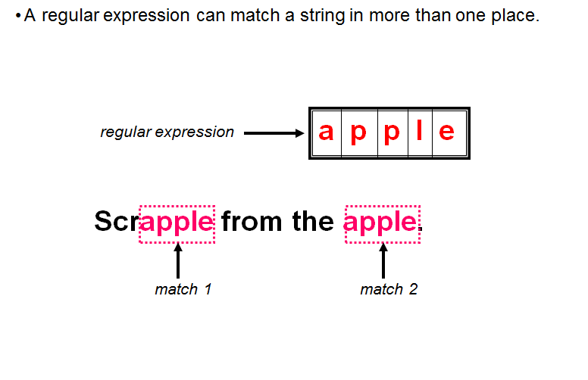
In web application String matching is used

Slide 58
Regular Expressions in Lexical Analysis
To perform lexical analysis, two components are required: a scanner and a tokenizer.
The purpose of tokenization is to categorize the lexemes found in a string to sort them by meaning.
The process can be considered a sub-task of parsing input.

Slide 59
For example, the C programming language could contain tokens such as numbers, string constants, characters, identifiers (variable names), keywords, or operators.
We can simply define a set of regular expressions, each matching the valid set of lexemes that belong to this token type. This is the process of scanning.

Slide 60
This process can be quite complex and may require more than one pass to complete. Another option is to use a process known as backtracking
For example, to determine if a lexeme is a valid identifier in C, we could use the following regular expression:
[a-zA-Z ][a-zA-Z 0-9]∗
This regular expression says that identifiers must begin with a Roman letter or an underscore and may be followed by any number of letters, underscores, or numbers

